Slide 1
Instant Auto Credit App
Instant Auto Credit App
powered by ProMax
Unique and highly effective
Using soft pull technology to increase your website credit leads and drive pre-qualified internet traffic to your dealership!
Unique and highly effective; using soft pull technology to increase your website leads

Slide 2
What is Instant Auto Credit App?
Instant Auto Credit App is a quick and easy application that can be integrated into any dealership’s website or used as a stand-alone micro site/special finance site. It allows customers on your website to instantly get pre-qualified and see their exact credit bureau score.
Additionally, the dealership will immediately receive a new lead which includes the customer’s contact info, exact credit bureau score, and auto summary information. How nice will it be having this information available when starting to work every new lead?

Slide 3
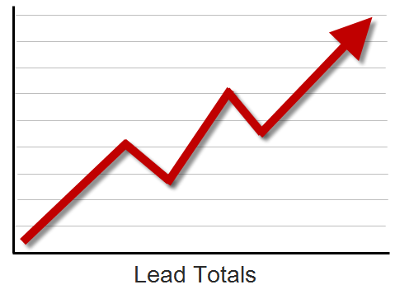
Why will it increase your website leads?
Because it incentivizes your visitors to provide their information to you. Doing so will set your website apart from your competitors’ generic and mundane lead forms.
Customers can instantly see if they are pre-qualified and for up to what loan amount and see their exact credit bureau score.
Instant Auto Credit App’s unique form attracts and engages customers.

Slide 4
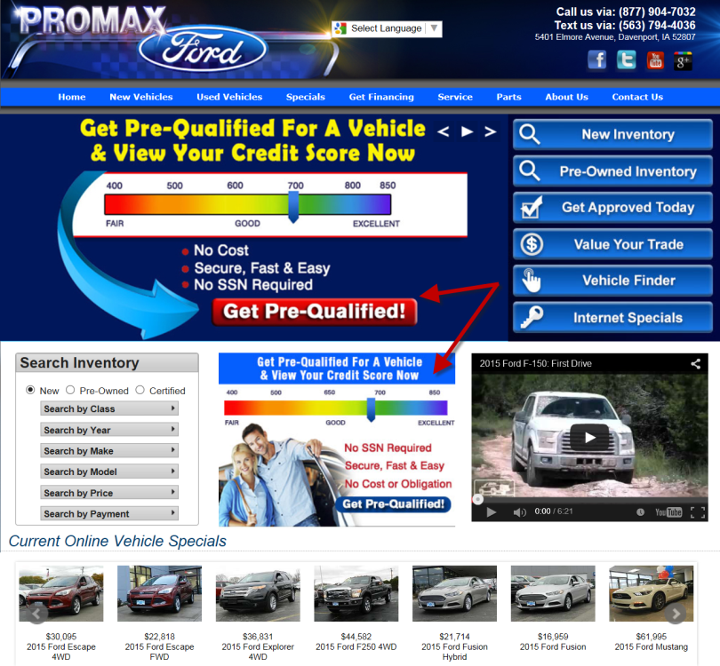
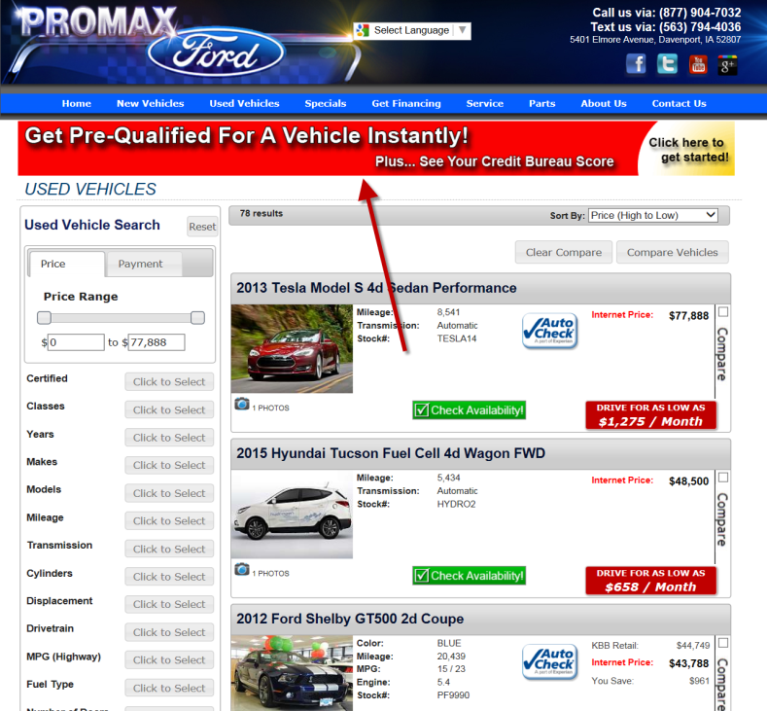
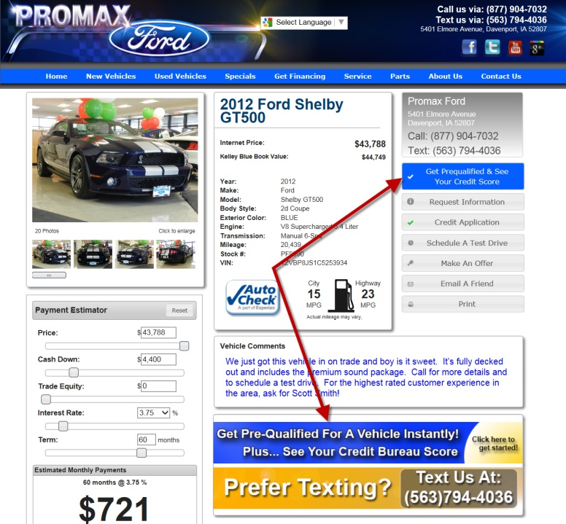
How the process works
All you have to do is contact your website provider and have them integrate the app into your website.
We can provide special promotional graphics that advertise the app or you can provide your own. You can place the app on as many pages of your website as you desire. Better placement equals more traffic and more leads!

Slide 5
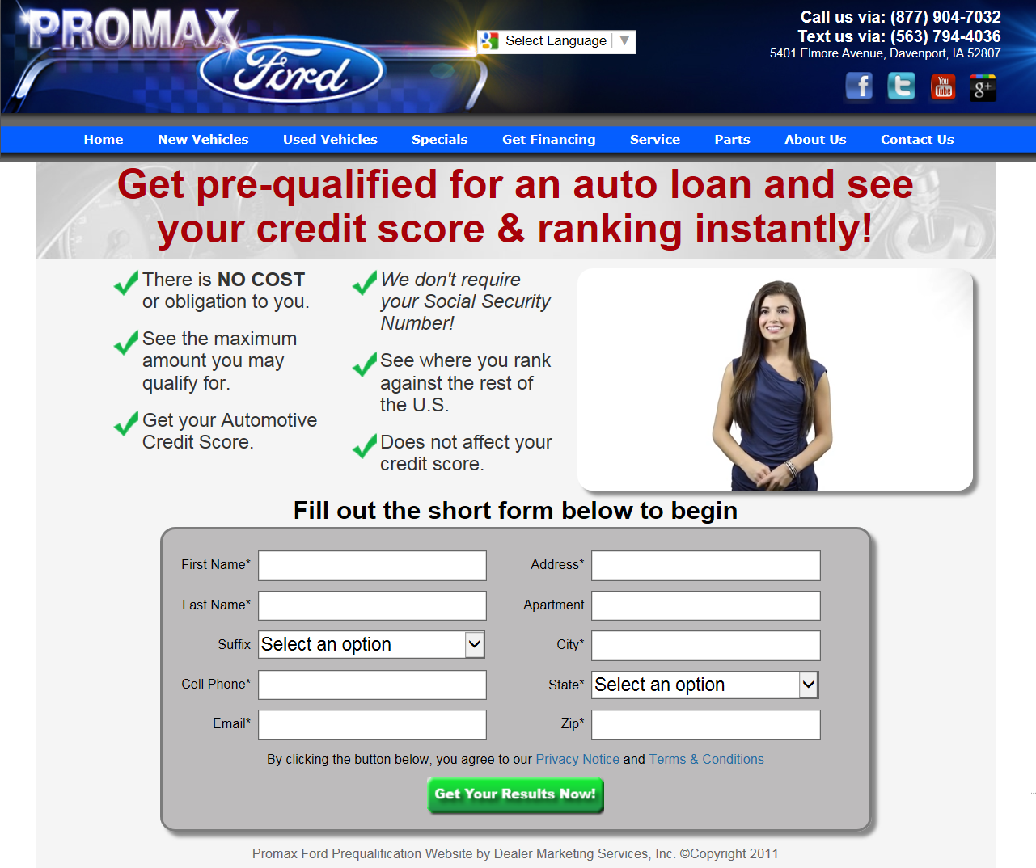
It couldn’t be easier for the customer
All the customer has to do is fill out the short form. They only need to provide name, address, and email… no social security number is required. It’s that quick and easy! A video spokesperson is included to explain how easy the process is.
No long forms
No cost or obligation to the customer
Does not affect the customer’s credit bureau score
Completely secure

Slide 6
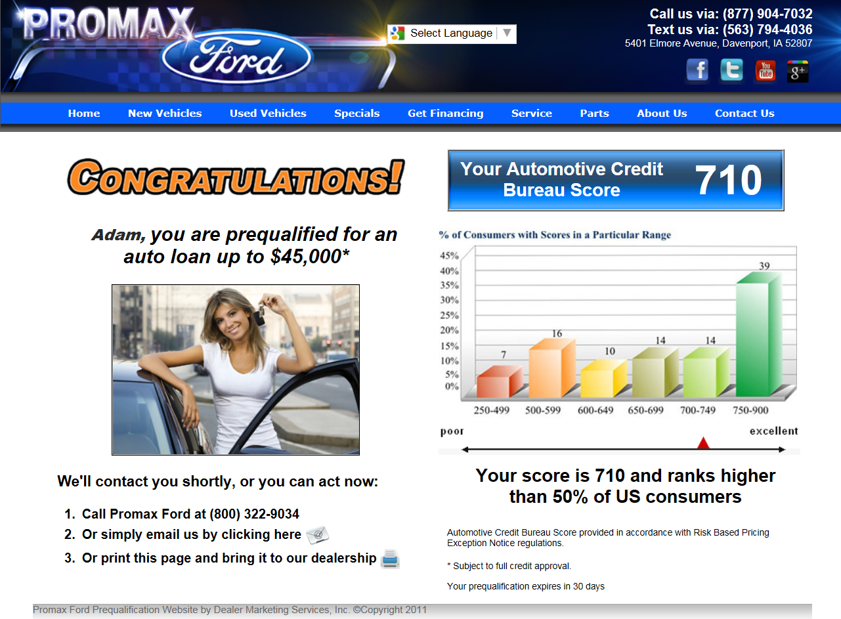
The customer will instantly see their results
Within seconds the customer will see if they are pre-qualified along with their exact credit bureau score. The pre-qualification tiers and loan amount can be customized per dealership.
Where else can a customer get this information this fast and this easy?

Slide 7
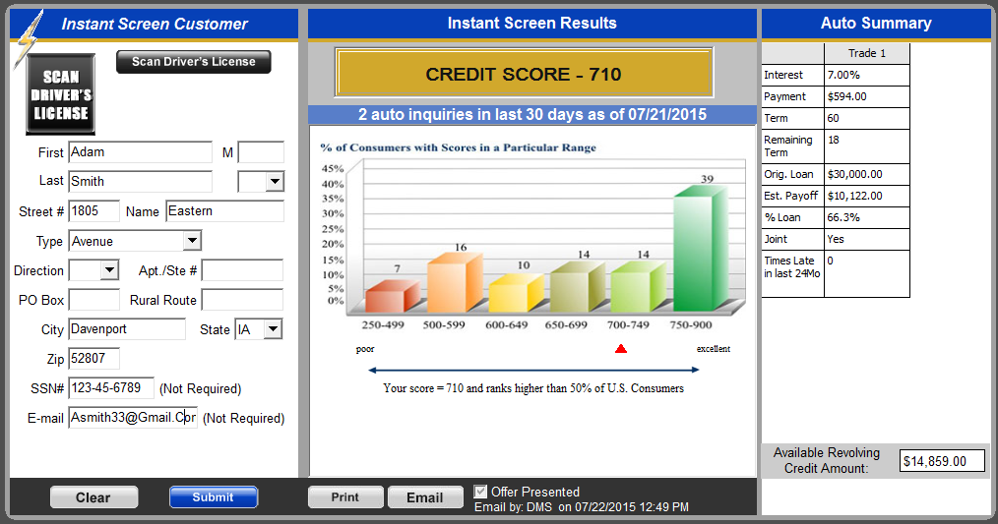
Receive unique & valuable information with every lead
With all other lead forms you only receive general contact information. Our leads are uniquely different. How great will it be to receive the information below?
With every prequalified lead you will receive the following: Customers exact credit bureau score, any auto inquires in the last 30 days, interest rate, payment, term of loan, remaining term, original loan amount, est. payoff, % loan paid off, if it was a joint loan, and number of late payments in the last 24 months.

Slide 8
Increase your sales & profits with the Instant Auto Credit App
The quality of our leads is exceptional. These are people on your website who want to get pre-qualified and start the purchasing process. Because of this, dealerships are seeing an increase in leads and closing ratios.
With every pre-qualified lead you receive valuable auto summary & credit information. This information gives you a distinct advantage when working every new lead.

Slide 9
Summary & Recap
Increase your website credit leads
High quality leads
Increase your closing ratios
Low cost per sale
Quick and easy for the customer – no long and tedious forms
No social security number required
Gratifying the customer with immediate results
Provides dealer with valuable credit and auto summary information giving them a distinct advantage when starting to work every new lead
Can also be used as a stand-alone micro site/special finance site
Completely secure
Very easy to incorporate into your existing website
Can be placed on as many pages as you want throughout your website
Can be used for email marketing and other places outside of your website

Slide 10
Instant Auto Credit App
Dealer Marketing Services, Inc.
Makers of ProMax Unlimited
563-344-7610

